Slide 1
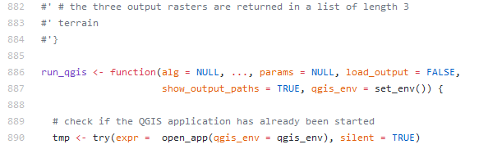

Integrating R with QGIS for Statistical Geocomputing
Jannes Muenchow, Patrick Schratz, Alexander Brenning
Notes:
Hello everybody, thank you for coming. Today I would like you to introduce to the RQGIS package. It integrates R with QGIS for advanced geocomputing since it combines the best of two worlds. ON the one hand it uses the geoprocessing power of QGIS and on the other hand it uses the statistical and analytical power of R.
Unbedingt Patrick Schratz danken

Slide 2
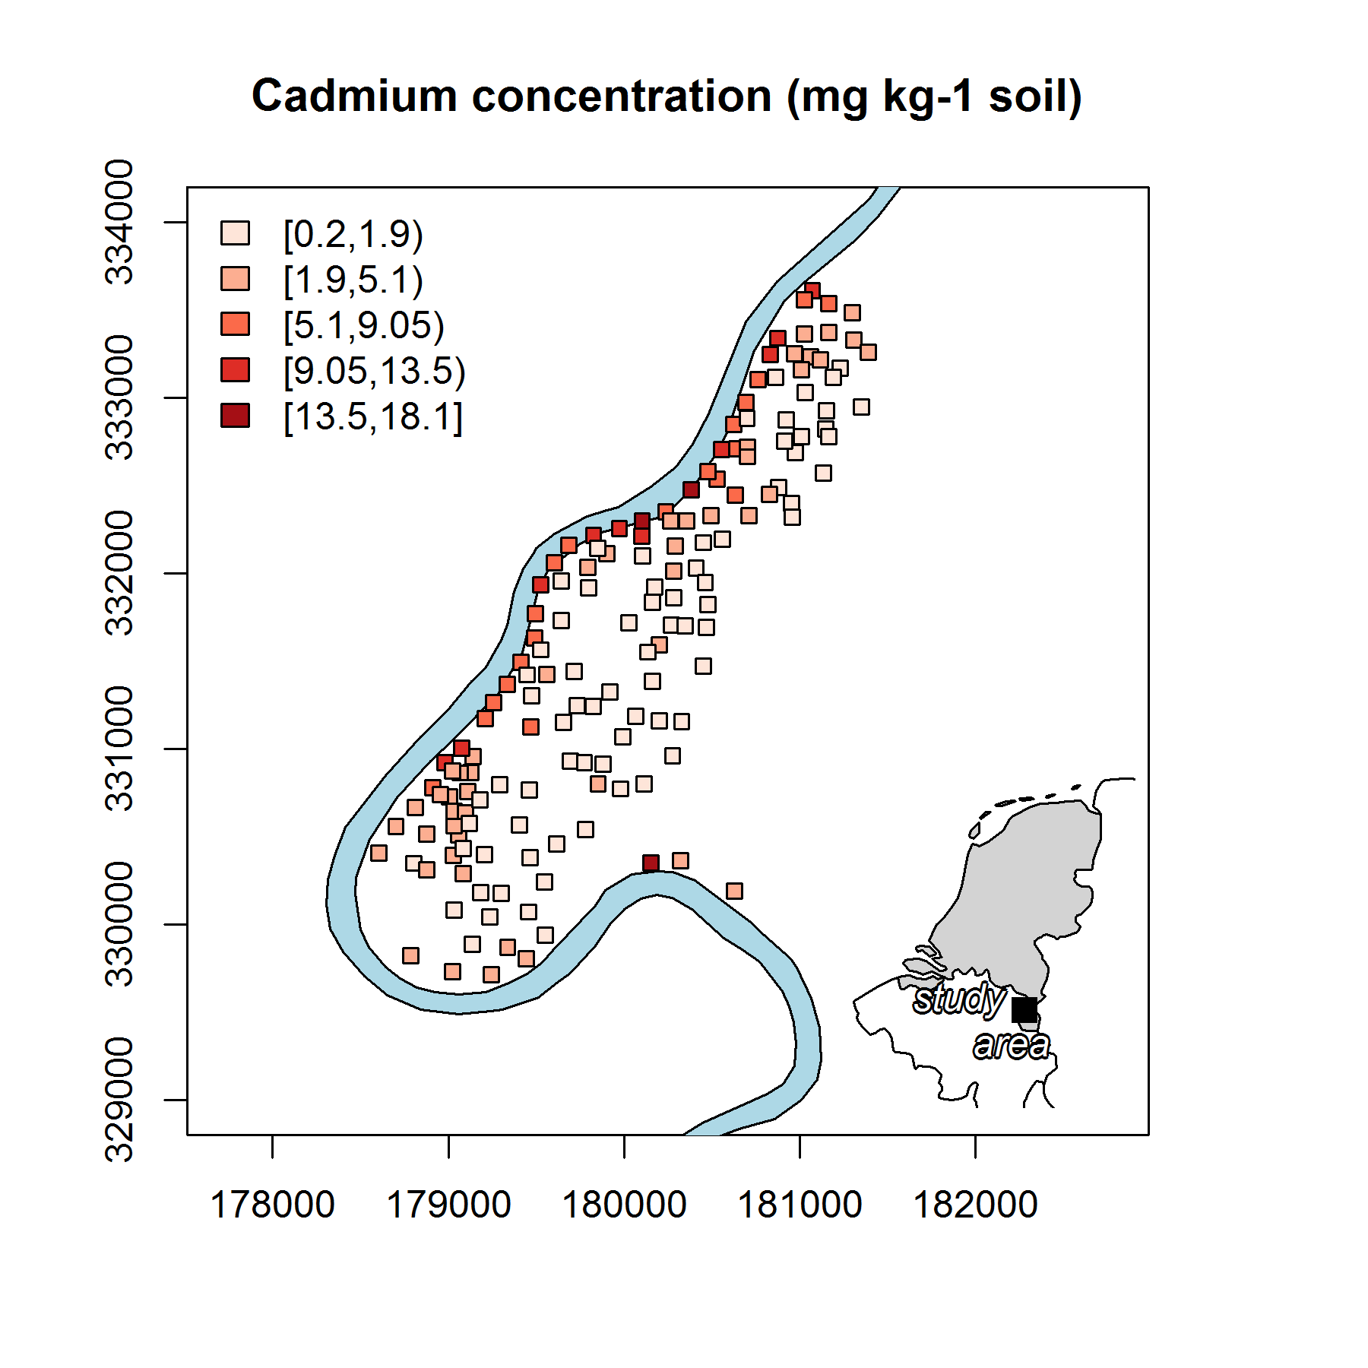



Contents
R as a GIS
RQGIS
R/GIS examples
RQGIS, RSAGA, rgrass7
Brenning et al. (2015): Landslide susceptibility near highways.
Data: Rikken, M.G.J & Van Rijn, R.P.G. (1993).

Slide 3

R as a GIS

Slide 4
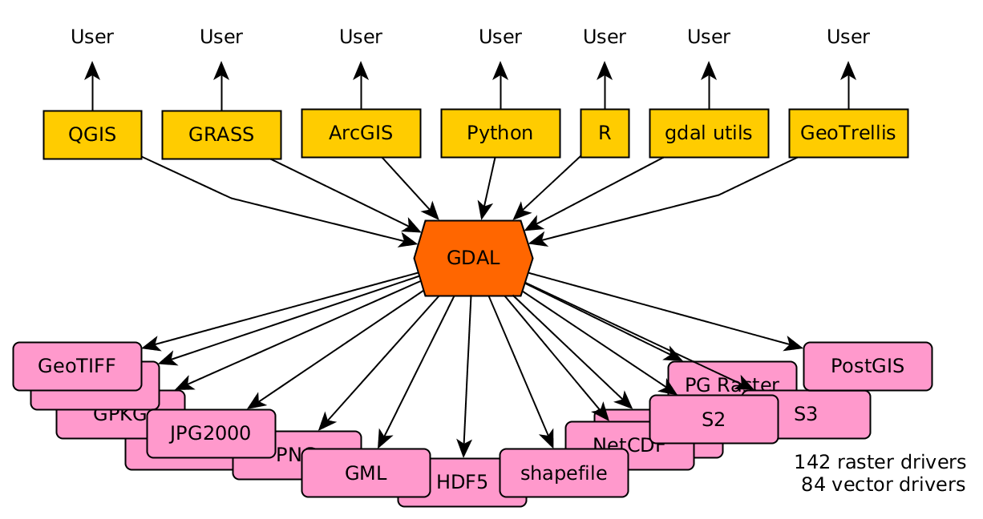
R as a GIS
More than 100 geo-related R packages (https://cran.r-project.org/web/views/Spatial.html)
Package rgdal for importing and exporting geodata
http://r-spatial.org//2016/11/29/openeo.html

Slide 5
R as a GIS
More than 100 geo-related R packages (https://cran.r-project.org/web/views/Spatial.html)
Package rgdal for importing and exporting geodata
Packages sp and sf for vector geodata
Data: Rikken, M.G.J & Van Rijn, R.P.G. (1993).

Slide 6
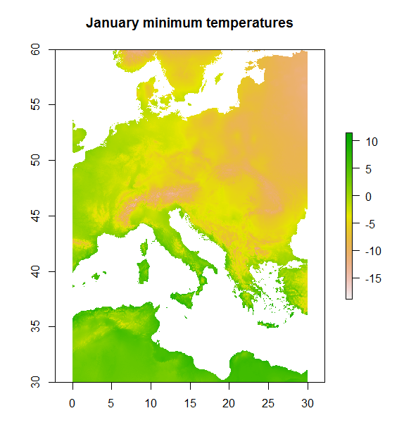
R as a GIS
More than 100 geo-related R packages (https://cran.r-project.org/web/views/Spatial.html)
Package rgdal for importing and exporting geodata
Packages sp and sf for vector geodata
Package raster for raster geodata
Data: http://www.worldclim.org/.

Slide 7
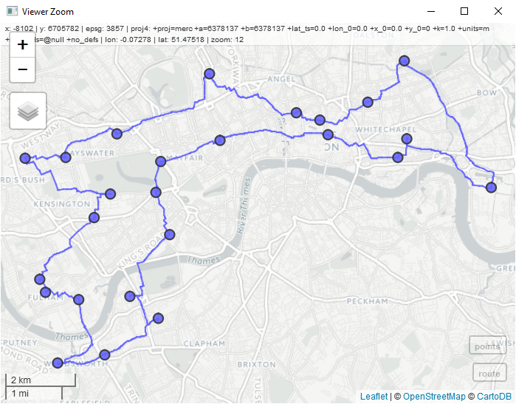
Interactive map handling
Interactive visualization through mapview (based on leaflet)
Notes:
Here, I only present a screenshot because I wasn‘t sure if I would have a working internet connection

Slide 8
R as a GIS
Defining a GIS as a system for the analysis, manipulation and visualization of geographical data (Longley, Goodchild, Maguire, and Rhind 2011), one could argue that R has become a GIS

Slide 9


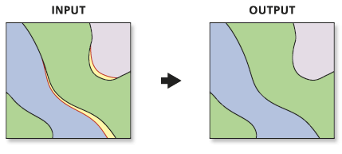
But what about…
(digitizing)
(Geodatabase-functionality
and topology rules)
http://www.unioneag.org
http://help.arcgis.com/
Notes:
- Mapedit but for small cartographic tasks
- R is definitely not a geodatabase (though we can access one from within R like PostGIS or also the GRASS geodatabase which is based on SQLlite)
- therefore, topological rules and related stuff is at best partially available in R

Slide 10
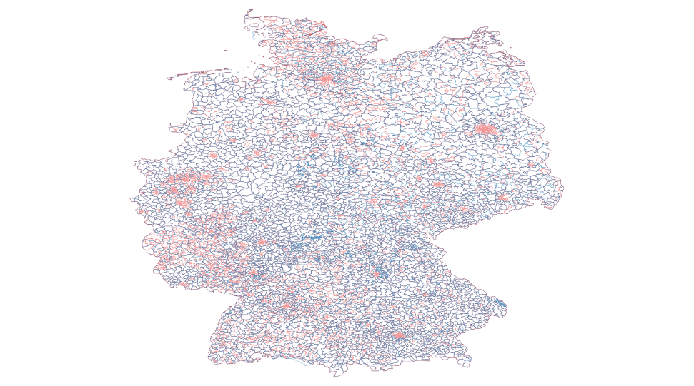
Computationally demanding operations
Computationally demanding operations

Slide 11
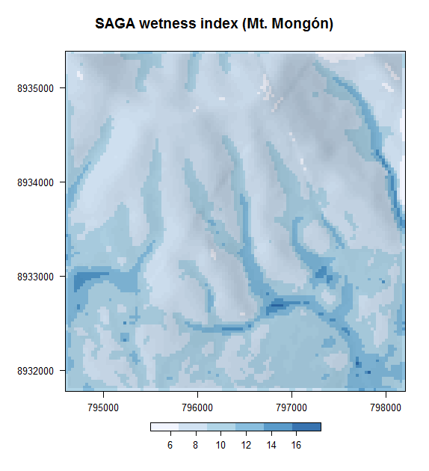
Missing geoalgorithms
Catchment area
Catchment slope
Saga Wetness Index
Lidar processing
…
Notes:
Virtually hundreds of geoalgorithms do not exist in R but that is not necessary

Slide 12
Interface
R has been designed from the beginning as an interactive interface to other software packages (Chambers, 2016).

Slide 13



R-GIS bridges
RSAGA
RQGIS
rgrass7
RPyGeo

Slide 14
Why (R)QGIS?
One of the most-widely used Desktop GIS
Unified interface
Quite user-friendly
Notes:
One of the most widely used Desktop-GIS, and therefore probably also very appealing to R users
Unified interface to several third-party providers, so you just need to know the syntax of one package to access all these different providers
Very user-friendly

Slide 15

RQGIS

Slide 16
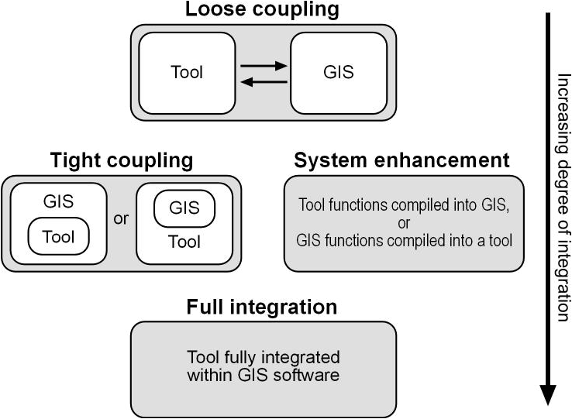
GIS interfaces
http://www.geocomputation.org/2000/GC009/Gc009.htm
Notes:
Loose coupling -> import and export of data
Tight coupling: access GIS functionalities from within R (tool); also possible to access R power from within GIS (e.g., GRASS, ArcGIS)

Slide 17
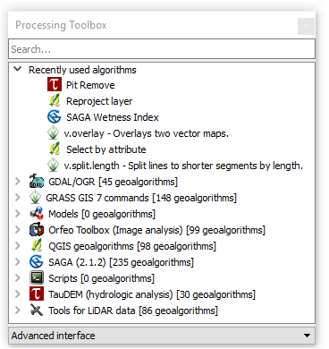
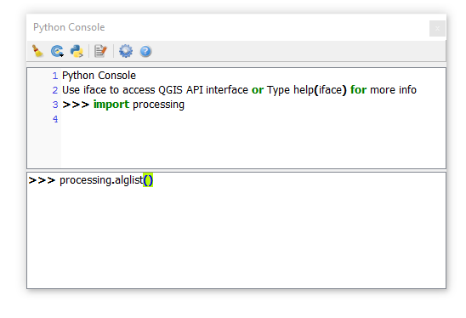
QGIS – Python API
Notes:
I think most of you are familiar with the processing toolbox of QGIS the QGIS processing toolbox from within R. These geoalgorithms can be accessed via the Python API. So I wondered if it was possible to do so also from within R.
Processing package is equivalent to the arcpy package of ArcGIS.

Slide 18



Python tunnel via reticulate
Python tunnel via reticulate (open_app())
find_algorithms()
get_usage()
Python QGIS
API
Notes:
So QGIS provides a so-called Python QGIS API, and we establish a tunnel to this API via the reticulate package. Reticulate is an R interface to Python and allows the seamless exchange of functions and objects between the two programming languages. Once, we establiseh this tunnel with the help of open_app, we can call any QGIS geoalgorithm without any overhead. We have created var
open_app()
find_algorithms()
get_usage()

Slide 19
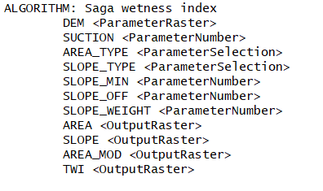
Example
library("RQGIS")
get_usage("saga:sagawetnessindex")
open_help("saga:sagawetnessindex")
Notes:
The 'SAGA Wetness Index' is, as the name says, similar to the 'Topographic Wetness Index' (TWI), but it is based on a modified catchment area calculation ('Modified Catchment Area'), which does not think of the flow as very thin film. As result it predicts for cells situated in valley floors with a small vertical distance to a channel a more realistic, higher potential soil moisture compared to the standard TWI calculation.
Wikipedia: The topographic wetness index (TWI), also known as the compound topographic index (CTI), is a steady state wetness index. It is commonly used to quantify topographic control on hydrological processes.[1] The index is a function of both the slope and the upstream contributing area per unit width orthogonal to the flow direction. The index was designed for hillslope catenas. Accumulation numbers in flat areas will be very large, so TWI will not be a relevant variable. The index is highly correlated with several soil attributes such as horizon depth, silt percentage, organic matter content, and phosphorus.[2] Methods of computing this index differ primarily in the way the upslope contributing area is calculated.

Slide 20
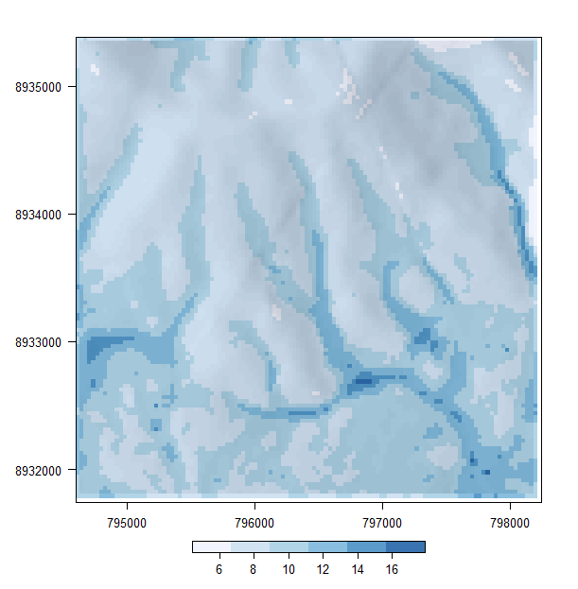
Let‘s run_qgis
data("dem")
twi <- run_qgis(
"saga:sagawetnessindex",
DEM = dem,
TWI = "twi.tif",
load_output = TRUE)
Notes:
So we use get_usage to find out how to use a geoalgorithm, and therefore we know that a geoalgorithm called grass7:r.slope.aspect requires as input a digital elevation model. Additionally, we specifiy an output file. And all other function parameters will be set to the default if there is one. Please note that the usage of R named arguments. This behaviour was inspired by the rgrass7. Note also that we can use spatial objects residing in R as input arguments. And if we set load_output to TRUE, the QGIS/GRASS output will be automatically loaded back into R

Slide 21
Let‘s run_qgis
Spatial object residing
in R
data("dem")
twi <- run_qgis(
"saga:sagawetnessindex",
DEM = dem,
TWI = "twi.tif",
load_output = TRUE)
Notes:
So we use get_usage to find out how to use a geoalgorithm, and therefore we know that a geoalgorithm called grass7:r.slope.aspect requires as input a digital elevation model. Additionally, we specifiy an output file. And all other function parameters will be set to the default if there is one. Please note that the usage of R named arguments. This behaviour was inspired by the rgrass7. Note also that we can use spatial objects residing in R as input arguments. And if we set load_output to TRUE, the QGIS/GRASS output will be automatically loaded back into R

Slide 22
Let‘s run_qgis
Spatial object residing
in R
data("dem")
twi <- run_qgis(
"saga:sagawetnessindex",
DEM = dem,
TWI = "twi.tif",
load_output = TRUE)
Loads automatically the QGIS output
back into R
Notes:
So we use get_usage to find out how to use a geoalgorithm, and therefore we know that a geoalgorithm called grass7:r.slope.aspect requires as input a digital elevation model. Additionally, we specifiy an output file. And all other function parameters will be set to the default if there is one. Please note that the usage of R named arguments. This behaviour was inspired by the rgrass7. Note also that we can use spatial objects residing in R as input arguments. And if we set load_output to TRUE, the QGIS/GRASS output will be automatically loaded back into R

Slide 23
Most notable features of RQGIS
Access to native QGIS geoalgorithms
Access to hundreds of further geoalgorithms, especially SAGA- and GRASS-geoalgorithms but also other third-party providers
R users can stay in their environment without having to touch Python
Support of R named arguments and automatic retrieval of default values
Data conversions

Slide 24

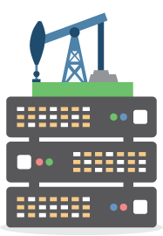
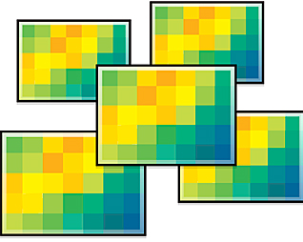
R-gis Examples

Slide 25
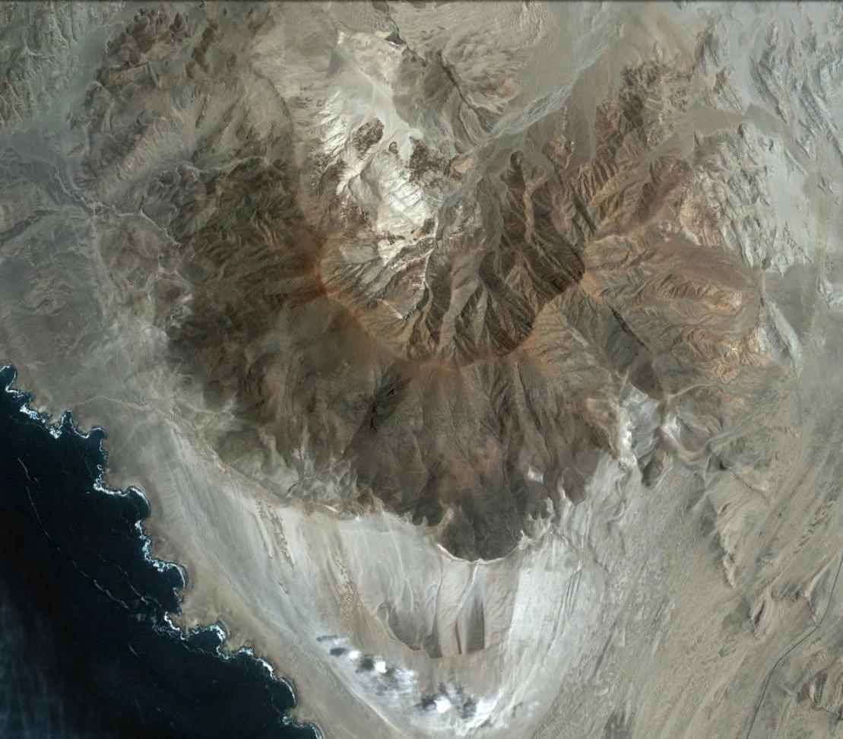
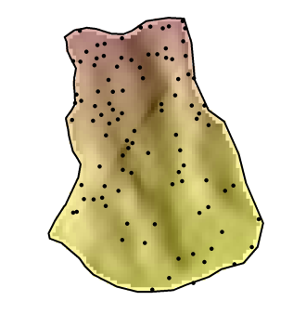
Study area – Mount Mongón
Mongón
Source: Google Earth.
Notes:
The study area is located in the Peruvian coastal desert. The mountain is called Mount Mongón and reaches an altitude of 1100 masl. I randomly sampled 100 locations/plots on the southern slope of this mountain. The plots were 4x4 meters in size and each of these plots I determined every single plant species.

Slide 26
Non-linear Poisson model
Predictors:
Altitude
catchment slope
catchment area
SAGA wetness index
Curvatures
solar radiation
etc.
Notes:
The catchment slope output grid of the Catchment Area (Parallel) module is computed like this: for each cell, the local slope is calculated using the approach of Zevenbergen & Thorne. These slope values are accumulated downslope. Finally, for each cell the accumulated slope values are divided by the derived catchment area of the cell. The unit of the grid are radians.
I guess you can think of it as an average slope value and not the slope value at a specific location

Slide 27
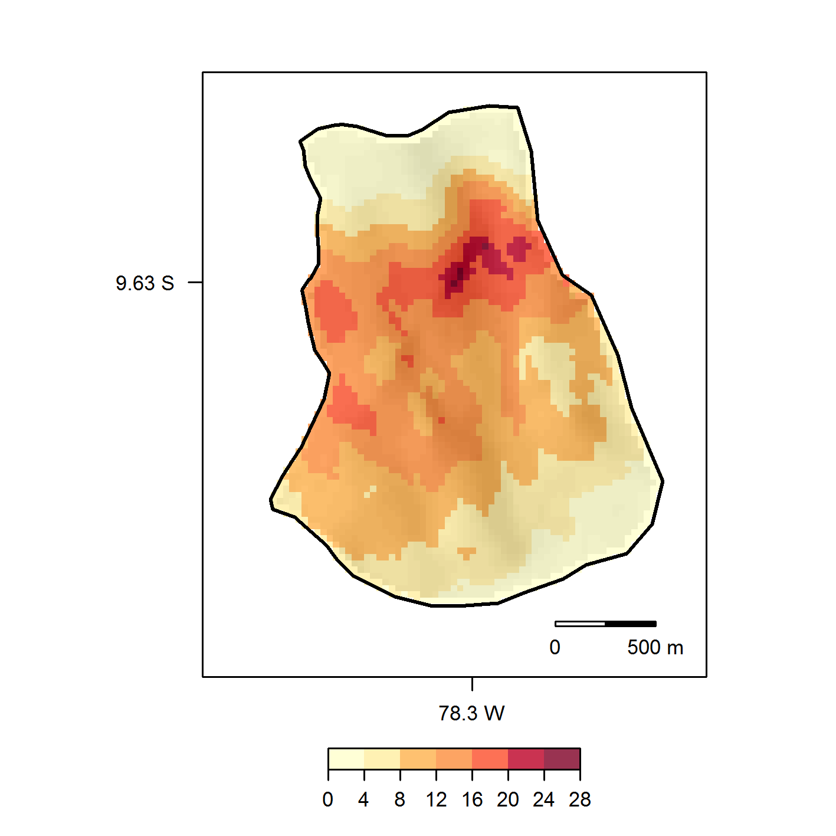
Spatial prediction of plant species diversity
Muenchow et al. (2013): Predictive mapping of species richness and plant species' distributions.
Notes:
GAM, GLM and other distributions, mixed-effect models, Bayesian models, machine learning, spatial cross-validation, incorporating spatial autocorrelation and kriging techniques
But that is just one example of R-GIS integration:
Stream networks
Surface roughness
Various wetness indexes
Terrain- and landform classification
Physically-based models
LiDAR tools
Wind speed, wind direction
Routing algorithms, neighbour calculations (topology)
Computationally demanding vector operations (overlay)

Slide 28
Landslide susceptibility
Brenning et al. (2015): Landslide susceptibility near highways.

Slide 29
Rock glaciers/permafrost
Computation of direct and diffuse incoming solar radiation
Azócar et al. (2017): Permafrost distribution modeling.

Slide 30
Geomarketing
Unioning postal code with municipality layers
Notes:
Soil classes and mapping (e.g., Brungard et al. 2015)
Stream networks (e.g., Hengl et al. 2010)
Climatology (rainfall prediction; e.g., Hengl et al. 2010)
Archeology (e.g., Borck 2016)
Socio-demography(population index prediction; e.g., Bajat et al. 2012)

Slide 31
Further applications
Soil classes and mapping (e.g., Brungard et al. 2015)
Stream networks (e.g., Hengl et al. 2010)
Climatology (rainfall prediction; e.g., Hengl et al. 2010)
Archeology (e.g., Borck 2016)
Socio-demography(population index prediction; e.g., Bajat et al. 2012)
…

Slide 32
comparing r/GIS Bridges
Notes:
I won‘t talk much about ESRI ArcGIS and instead focus on the comparison between RQGIS and RSAGA and rgrass7

Slide 33
RQGIS vs. RSAGA/rgrass7
Unified interface to SAGA, GRASS and further 3rd-party providers
User-friendly
open_help()
R named arguments
Automatic retrieval of default values
On-the-fly import/export of spatial objects (run_qgis)
Automatic data conversions (e.g., asc, tif, etc.)

Slide 34
But:
QGIS does not provide access to all SAGA and GRASS functionalities
RSAGA has special geocomputing functions (written in R)
QGIS establishes a new GRASS session for each call and barely supports the GRASS geodatabase
Notes:
Special SAGA functions multi.local.function, grid.predict, pick.from.ascii.grids

Slide 35

Wrap-up
We can use R as a GIS
Geoprocessing is (often) better done with the help of a GIS
R-GIS integration combines the best of two worlds
RQGIS, RSAGA, rgrass7 are all great
http://www.myazpiration.com/wp-content/uploads/
2014/11/Partnership-5.png
http://www.esri.com/
https://7segments.com/
Data: Rikken, M.G.J & Van Rijn, R.P.G. (1993).
Notes:
Main advantages of RQGIS:
Most popular desktop GIS
Lets the user also access third-party providers (SAGA, GRASS, OTB, Taudem, …)
Easier to use for non-GISexperts (data conversions, get_args_man)
QGIS geoalgorithms

Slide 36
Rqgis usage

Slide 37
RQGIS on github
Find out how to use RQGIS on github:
http://jannes-m.github.io/RQGIS/index.html

Slide 38
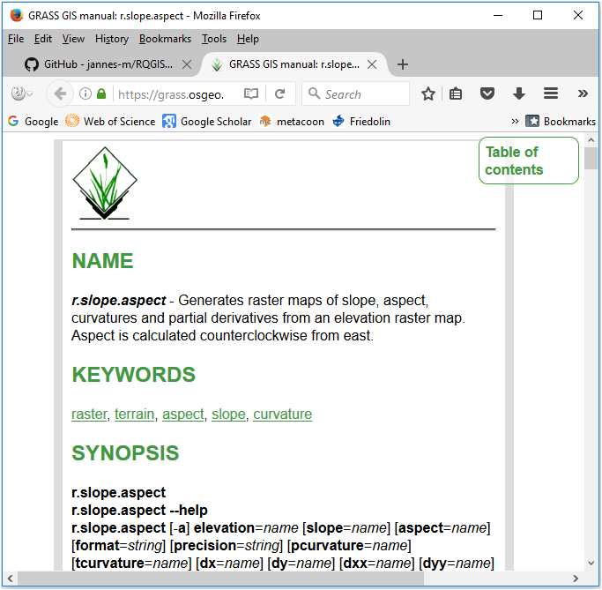
Access to the online help
Let‘s run:
library("RQGIS")
qgis_env <- set_env("C:/OSGeo4W64/")
open_help(alg = "grass7:r.slope.aspect",
qgis_env = qgis_env)

Slide 39
Automatic argument retrieval
The QGIS Python API does not provide a way to collect function arguments of a geoalgorithm. You can only do that:
processing.alghelp("grass7:r.slope.aspect")

Slide 40
ALGORITHM: r.slope.aspect - Generates raster layers of slope, aspect, curvatures and partial derivatives from a elevation raster layer.
elevation <ParameterRaster>
format <ParameterSelection>
precision <ParameterSelection>
-a <ParameterBoolean>
zscale <ParameterNumber>
min_slope <ParameterNumber>
GRASS_REGION_PARAMETER <ParameterExtent>
GRASS_REGION_CELLSIZE_PARAMETER <ParameterNumber>
slope <OutputRaster>
aspect <OutputRaster>
pcurvature <OutputRaster>
tcurvature <OutputRaster>
dx <OutputRaster>
dy <OutputRaster>
dxx <OutputRaster>
dyy <OutputRaster>
dxy <OutputRaster>
format(Format for reporting the slope)
0 - degrees
1 - percent
precision(Type of output aspect and slope layer)
0 - FCELL
1 - CELL
2 - DCELL

Slide 41
Convenience function get_args_man
However, get_args_man let‘s you automatically collect all function arguments and default values of a specific geoalgorithm.
R> params <- get_args_man(alg = "grass7:r.slope.aspect",
R+ options = TRUE, qgis_env = qgis_env)
R+ params
$elevation
[1] "None"
$format
[1] "0"
…

Slide 42
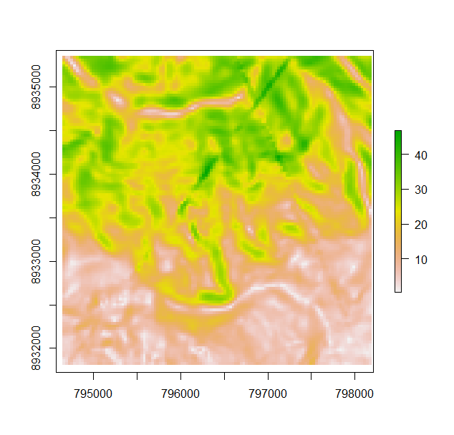
Let‘s run_qgis
Spatial object residing
in R
data("dem")
params$elevation <- dem
params$slope <- file.path(tempdir(), "slope.tif")
slope <- run_qgis(
"grass7:r.slope.aspect", params = params, qgis_env = qgis_env,
load_output = TRUE)
data("dem")
params$elevation <- dem
params$slope <- file.path(tempdir(), "slope.tif")
Loads automatically the QGIS ouptut
back into R

